Slide 1
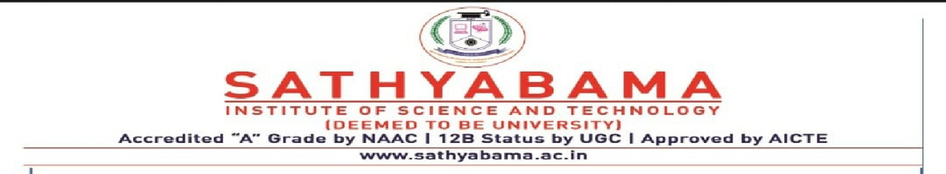
Dynamic Pricing Prediction For Cabs Using Machine Learning
Project Done By : K Pavan Chandra
Project Guide : Mr. A. Yovan Felix
Registration No: 39110518

Slide 2
Presentation Outline :
Introduction
Course Certification
Solution Requirement
Technical Architecture
Pre-requisites
Packages To Install
Project Objectives
Project Flow
Project Folder Structure
Installation Of Required Packages
Importing The Libraries
Prediction Of Final Result

Slide 3
Introduction: Many organizations do not have a direct role in travel and tourism but offer related products and services. Some examples would be offering travel insurance, parking facilities at airports, theatre and event tickets, car hire, and travel by rail or coach to airports, etc. at competitive rates. There are various different forms of dynamic pricing. 1. Peak Pricing – This is a strategy that is common in transportation businesses. Airlines are a good example. Airlines often charge a higher price to travel during rush hour mostly on weekdays and sometimes on weekends. 2. Surge Pricing – Companies such as Uber respond dynamically to changes in supply and demand in order to price their services differently. Like most of us have noticed, this frequently happens on stormy evenings and nights when more people request for cabs. Taxify also not so long ago introduced dynamic pricing to ensure the drivers are encouraged to go online and offer services when the demand is high.

Slide 4
Course Certificate

Slide 5
Solution Requirement:
Every day the price of travel was changed due to the demand for public uses. The framework developed for the price prediction is analyzed for the travel plans. For the same travel plan offered at a fixed price for a particular group of customers, our proposed model saw a final fare with a lesser number of errors in predicting customer planning. As time progresses and more data are collected, the supervised learning will produce more accurate results and will be helpful in determining fare optimizer and dynamic availability of adjustments and continuously improve future recommendations.

Slide 6
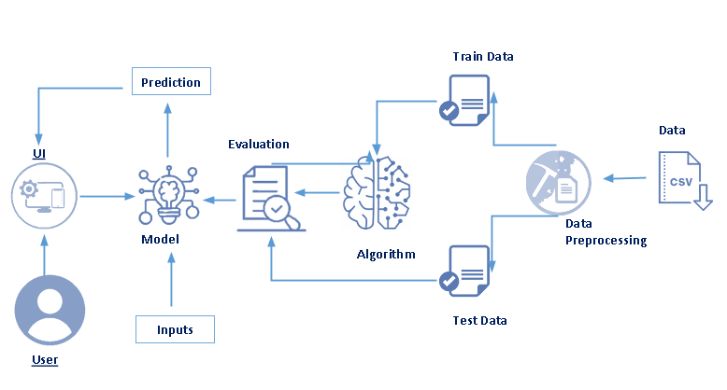
Technical Architecture :

Slide 7
Pre – Requisites :
In order to develop this project we need to install following software/packages:
Anaconda Navigator :
Anaconda Navigator is a free and open-source distribution of the Python and R programming languages for data science and machine learning related applications. It can be installed on Windows, Linux, and macOS. Conda is an open-source, cross-platform, package management system. Anaconda comes with so very nice tools like JupyterLab, Jupyter Notebook,
QtConsole, Spyder, Glueviz, Orange, Rstudio, Visual Studio Code. For this project, we will be using Jupyter notebook and Spyder

Slide 8
Packages To Install :
If you are using anaconda navigator, follow below steps to download required packages:
Open the anaconda prompt.
Type "pip install requests” and click enter.
Type “pip install Flask” and click enter.
If you are using Pycharm IDE, you can install the packages through the command prompt and follow the same syntax as above.
Prior Knowledge : One should have knowledge on the following Concepts:
Requests: Allows you to send HTTP requests using Python.
Flask: Web framework used for building Web applications.

Slide 9
Project Objectives :
Write what are all the technical aspects that students would get if they complete this project.
Knowledge on Machine Learning Algorithms.
Knowledge on Python Language with Machine Learning
Knowledge on Statistics and Graphs and their relations
You’ll be able to understand the problem to classify if it is a regression or a classification kind of problem.
You will be able to know how to pre-process / clean the data using different data pre-processing techniques.
Applying different algorithms according to the dataset and based on visualization.
Real Time Analysis of Project
Building an ease of User Interface (UI)
Navigation of ideas towards other projects(creativeness)
Knowledge on building ML Model..
You will be able to know how to find the accuracy of the model.
How to Build web applications using the Flask framework.

Slide 10
Project Flow :
Install Required Libraries.
Data Collection.
Collect the dataset or Create the dataset
Data Pre- processing.
Import the Libraries.
Importing the dataset.
Understanding Data Type and Summary of features.
Take care of missing data & create columns.
Data Visualization.
Drop the column from dataframe ,merge the dataframes.
Observing Target,Numerical and Categorical Columns
Label Encoding & Splitting the Dataset into Dependent and Independent variables
Splitting Data into Train and Test.

Slide 11
Model Building :
Training and testing the model
Evaluation of Model
Saving the Model
Application Building
Create an HTML file
Build a Python Code
Final UI
Dashboard Of the flask app.

Slide 12
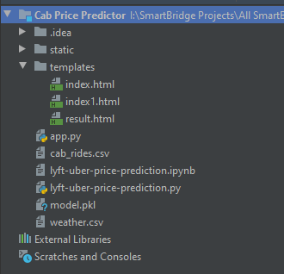
Project Folder Structure :
We are building a Flask Application which needs HTML pages “index.html” ,“index1.html” ,“result.html” stored in the templates folder and a python script app.py for server side scripting
The model is built in the notebook lyft-uber-price-prediction.ipynb
We need the model which is saved and the saved model in this content is model.pkl.
The static folder will contain a css file which is used in the html file.
The templates mainly used here are “index.html”,”index1.html”, “result.html” for showcasing the UI
The flask app is denoted as app.py

Slide 13
Install Required Packages :
To complete the project, you need the following packages and libraries.
Anaconda Navigator
Jupyter
Numpy
Pandas
Matplotlib
Scikit-Learn
Install Anaconda software
To install Anaconda on your local system, go through the below links according to your system requirements. After Anaconda is installed, run the .exe folder.

Slide 14
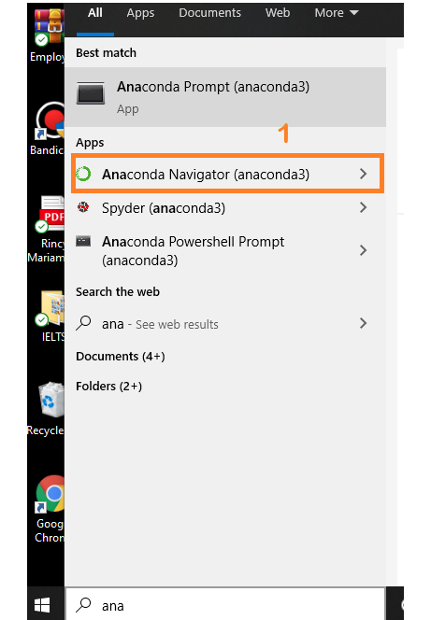
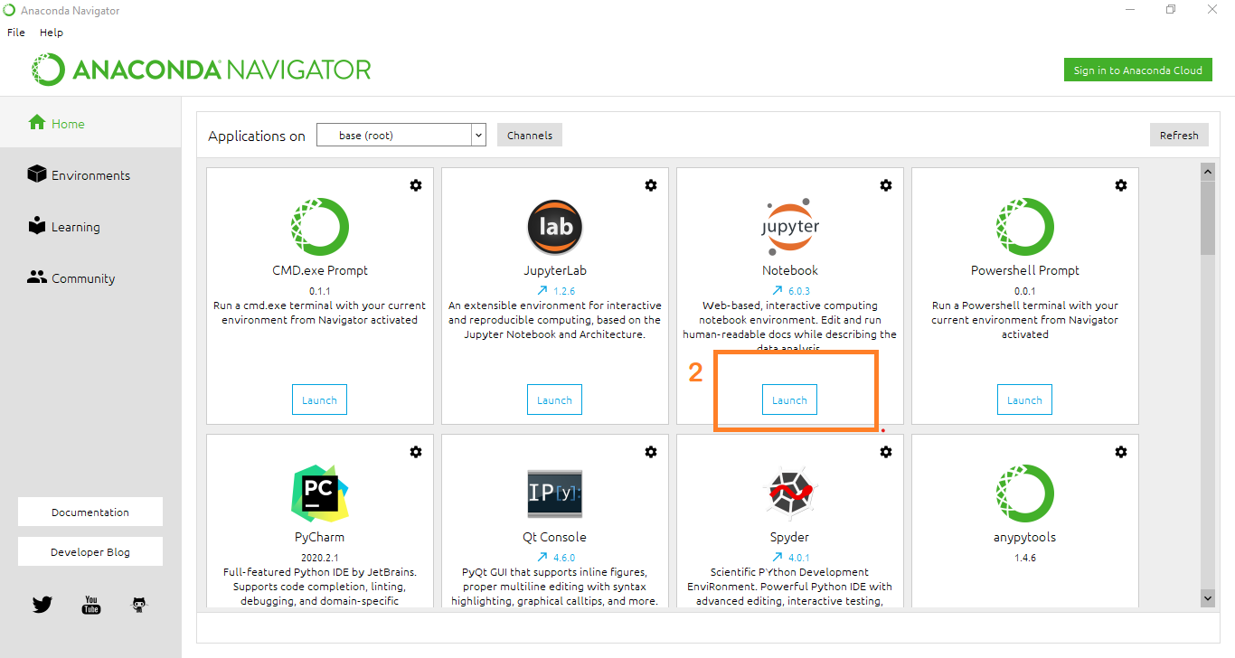
Install Required Libraries :

Slide 15
Installation Of Libraries :
Installation of Numpy Library :
Using Anaconda Navigator: conda install numpy
OR
Using command prompt: pip install numpy.
Installation of Pandas Library :
Using Anaconda Navigator: conda install pandas
OR
Using command prompt: pip install pandas.

Slide 16
Installation of Matplotlib Library :
Using Anaconda Navigator: conda install matplotlib
OR
Using command prompt: pip install matplotlib
Installation of Scikit-Learn Library :
Using Anaconda Navigator: conda install -c conda-forge scikit-learn
OR
Using command prompt: pip install -U scikit-learn

Slide 17
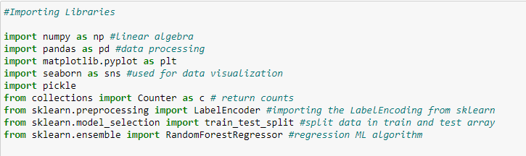
Import The Libraries
Import the required libraries for the model to run.
First step is usually importing the libraries that will be needed in the program.

Slide 18
Numpy- It is an open-source numerical Python library. It contains a multi-dimensional array and matrix data structures. It can be used to perform mathematical operations on arrays such as trigonometric, statistical, and algebraic routines. Pandas objects are very much dependent on NumPy objects.
Pandas- It is a fast, powerful, flexible and easy to use open source data analysis and manipulation tool, built on top of the Python programming language.
Counter: Python Counter is a container that will hold the count of each of the elements present in the container.
Matplotlib and Seaborn: Both are the data visualization library used for plotting graphs which will help us to understand the data.
Accuracy score: used in classification type problems and for finding accuracy.

Slide 19
Train_test_split: used for splitting data arrays into training data and for testing data.
Pickle: to serialize your machine learning algorithms and save the serialized format to a file.
Random Forest Regressor: random forest is a meta estimator that fits a number of classifying decision trees on various sub-samples of the dataset and uses averaging to improve the predictive accuracy and control over-fitting. The sub-sample size is controlled with the max_samples parameter if bootstrap=True (default), otherwise the whole dataset is used to build each tree.
Label Encoding: It is a popular encoding technique for handling categorical variables. In this technique, each label is assigned a unique integer based on alphabetical ordering.

Slide 20
Reading The Dataset
Here, we are reading the dataset(.csv) from the system using pandas and storing it in a variable ‘df’. It's time to begin building your text classifier! The data has been loaded into a DataFrame called df. The .head() method is particularly informative.
You might have your data in .csv files, .excel files or .tsv files or something else. But the goal is the same in all cases. If you want to analyse that data using pandas, the first step will be to read it into a data structure that’s compatible with pandas.
Let’s load a .csv data file into pandas. There is a function for it, called read_csv().We will need to locate the directory of the CSV file at first (it’s more efficient to keep the dataset in the same directory as your program).
There are two dataset one is representing the data of Cab Rides and another one is representing for weather data.

Slide 21
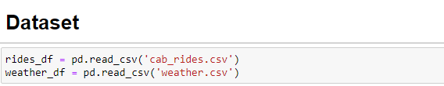
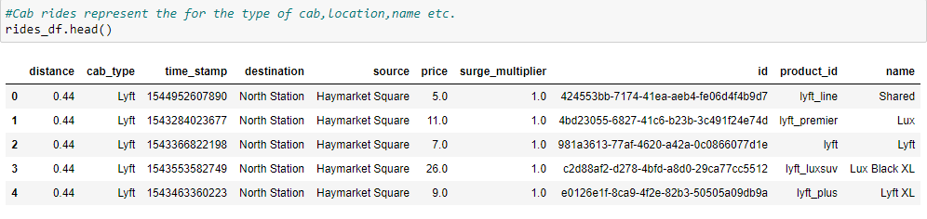
If the dataset is in the same directory of your program, you can directly read it.
To check the top five records of the dataset,simply write the dataframe name.head().
Rides_df represent the data for the cab rides like type of cab,location,name etc.

Slide 22
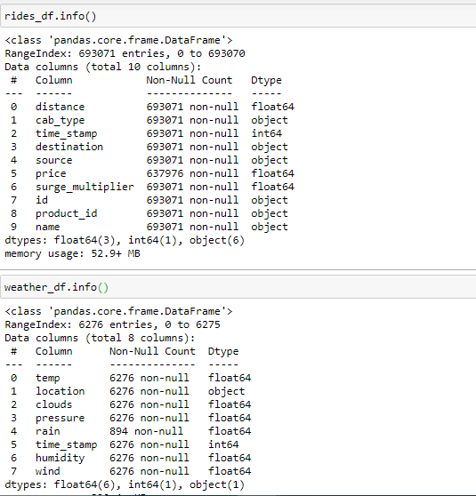
Understanding Datatype & Summary Of Features

Slide 23
How the information is stored in a DataFrame or Python object affects what we can do with it and the outputs of calculations as well. There are two main types of data : numeric and text data types.
Numeric data types include integers and floats.
Text data type is known as Strings in Python, or Objects in Pandas. Strings can contain numbers and / or characters.
For example, a string might be a word, a sentence, or several sentences.
Will see how our dataset is, by using info() method.
info() method provides the summary of dataset.

Slide 24
Take Care Of Missing Data & Create Columns :
Sometimes you may find some data missing in the dataset. We need to be equipped to handle the problem when we come across them. Obviously you could remove the entire line of data but what if you are unknowingly removing crucial information? Of course we would not want to do that. One of the most common ideas to handle the problem is to take a mean of all the values for continuous and for categorical we make use of mode values and replace the missing data.
Word “True” that the particular column has missing values, we can also see the count of missing values in each column by using isna().sum function.

Slide 25
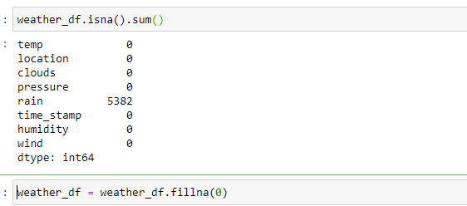
Converting the timestamp data into real date format & Creating the new column that contain the location and source. Using the datetime method to convert the time stamp into real date format

Slide 26
Train And Test The Model Using Random Forest Regressor.
There are several Machine learning algorithms to be used depending on the data you are going to process such as images, sound, text, and numerical values. The algorithms that you can choose according to the objective that you might have it may be Classification algorithms are Regression algorithms.
Example: 1. Linear Regression
2. Logistic Regression.
3. Random Forest Regression / Classification.
4. Decision Tree Regression / Classification.
You will need to train the datasets to run smoothly and see an incremental improvement in the prediction rate.
Now we apply the Random forest regressor algorithm on our dataset.

Slide 27
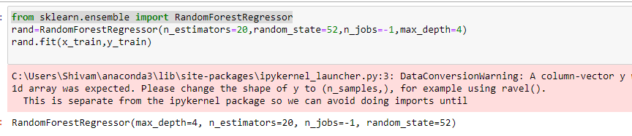
A Random Forest is an ensemble technique capable of performing both regression and classification tasks with the use of multiple decision trees and a technique called Bootstrap and Aggregation, commonly known as bagging. The basic idea behind this is to combine multiple decision trees in determining the final output rather than relying on individual decision trees.
Build the model with the Random Forest Regressor.
We’re going to use x_train and y_train obtained above in train_test_split section to train our Random forest regression model. We’re using the fit method and passing the parameters as shown below.

Slide 28
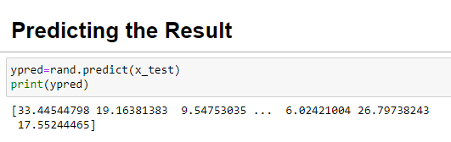
Predict the values : Once the model is trained, it’s ready to make predictions. We can use the predict method on the model and pass x_test as a parameter to get the output as y_pred. Notice that the prediction output is an array of real numbers corresponding to the input array.

Slide 29
The End

